Slide 1

WIFI-CONTROLLED LED USING ESP8266

Slide 2

PROBLEM STATEMENT
Manually operating electrical appliances can be inefficient and inconvenient, especially when remote access is needed. Traditional methods require physical presence to switch appliances ON or OFF, leading to unnecessary power consumption and limited accessibility. This project addresses these issues by implementing an IoT-based relay control system, enabling users to remotely manage electrical appliances through the Blynk mobile app.

Slide 3
ABSTRACT
This project presents an IoT-based relay control system using the Blynk platform to enable remote control of electrical appliances. The system utilizes an ESP8266 microcontroller, a relay module, and Wi-Fi connectivity to allow users to toggle devices on and off via a mobile application. By integrating IoT technology, the project enhances convenience, energy efficiency, and automation in home and industrial settings. Future enhancements may include voice control, scheduling, and energy monitoring to improve functionality and security.

Slide 4
INTRODUCTION
IoT has transformed home automation by enabling remote control of appliances. This project develops an IoT-based relay control system using ESP8266 and Blynk, allowing users to operate devices via a mobile app. It enhances convenience, energy efficiency, and real-time monitoring, making it suitable for smart homes and industrial use.

Slide 5
KEY FEATURE
Remote Control: Users can switch appliances ON/OFF via the Blynk mobile app from anywhere.
Wi-Fi Connectivity: The system utilizes ESP8266 for wireless communication.
Real-Time Monitoring: The app provides live status updates of connected devices.
Energy Efficiency: Helps reduce unnecessary power consumption by remotely managing devices.
Scalability: The system can be expanded to control multiple devices.
User-Friendly Interface: Simple mobile app controls make it accessible for all users.

Slide 6
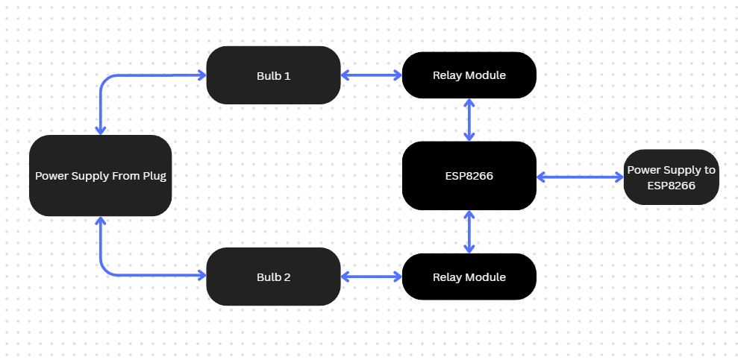
BLOCK DIAGRAM

Slide 7
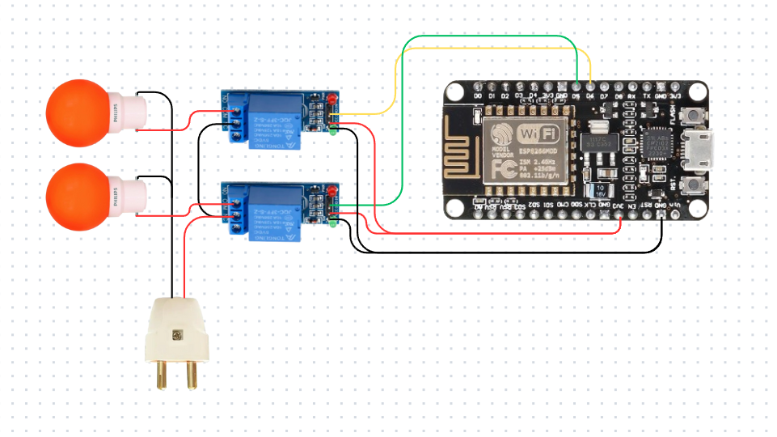
CIRCUIT DIAGRAM

Slide 8
USE CASE
Home Automation: Enables users to control household appliances like lights, fans, and air conditioners remotely.
Office & Commercial Spaces: Helps manage electrical equipment, reducing energy waste and improving efficiency.
Industrial Automation: Useful in factories to control machinery and ensure safety compliance.
Security Systems: Integrates with smart locks, cameras, and alarms for enhanced home security.

Slide 9
OUTCOME
The IoT-based relay control system successfully demonstrates the ability to remotely control electrical appliances via the Blynk mobile app. The system enhances convenience, energy efficiency, and security by enabling real-time monitoring and operation of devices. The project showcases how IoT can improve home and industrial automation while reducing unnecessary power consumption. Future expansions, such as voice control and automation scheduling, can further enhance the system’s usability and reliability.

Slide 10
CONCLUSION
The IoT-based relay control system using Blynk proves to be an effective solution for remote home and industrial automation. By integrating IoT technology, the system enhances energy efficiency, convenience, and real-time monitoring. The project demonstrates the practicality of using ESP8266 and Blynk for wireless control of electrical appliances, providing a scalable and user-friendly solution.
Although challenges such as Wi-Fi dependency and security concerns exist, future improvements like voice control, scheduling, and power consumption tracking can further optimize the system. With continued advancements in IoT, this system can evolve into a comprehensive smart automation platform, making daily life more efficient and connected.

